Slide 1
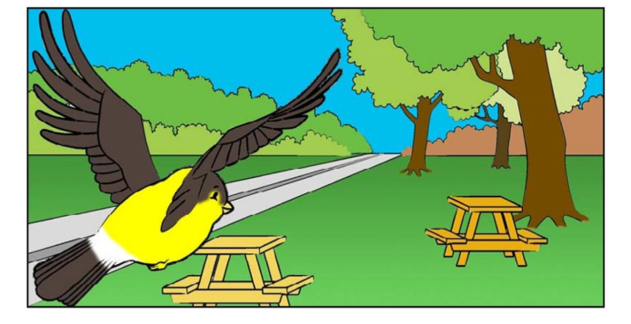
Bird Goes Home

Slide 2
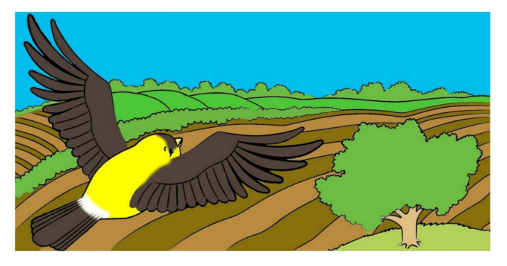
The bird goes over the tree.

Slide 3
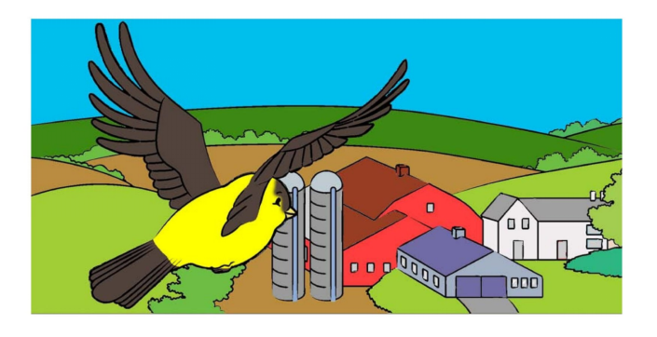
The bird goes over the farm.

Slide 4
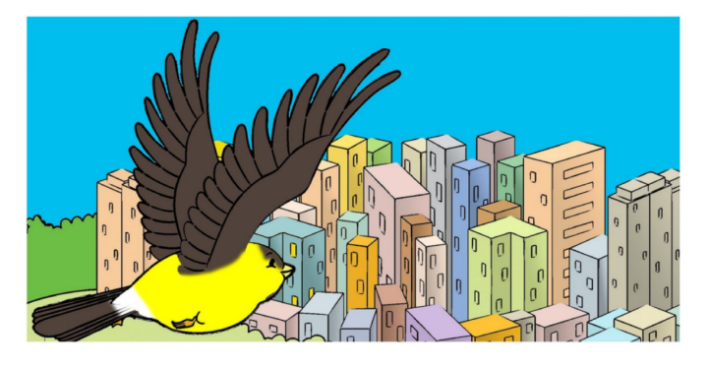
The bird goes over the city.

Slide 5
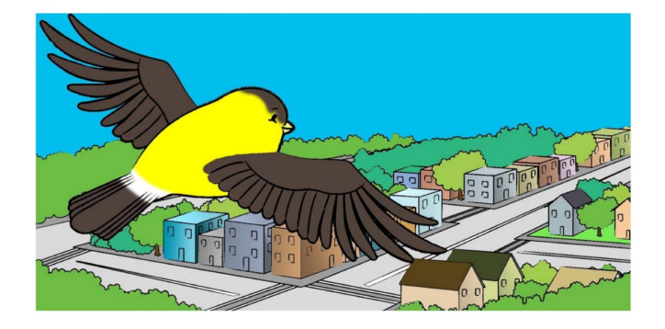
The bird goes over the street.

Slide 6
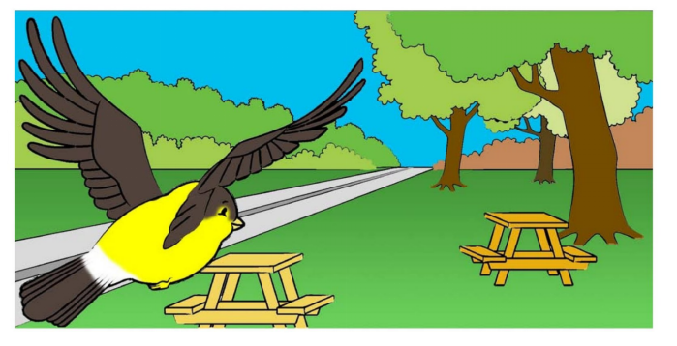
The bird goes over the tables.

Slide 7
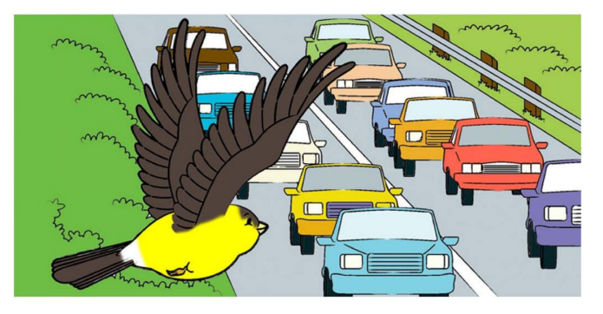
The bird goes over the cars.

Slide 8
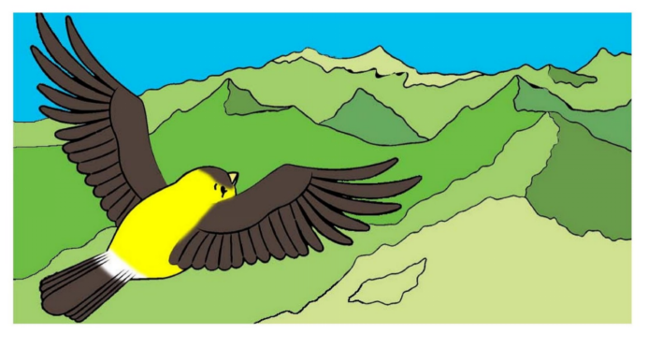
The bird goes over the mountains.

Slide 9
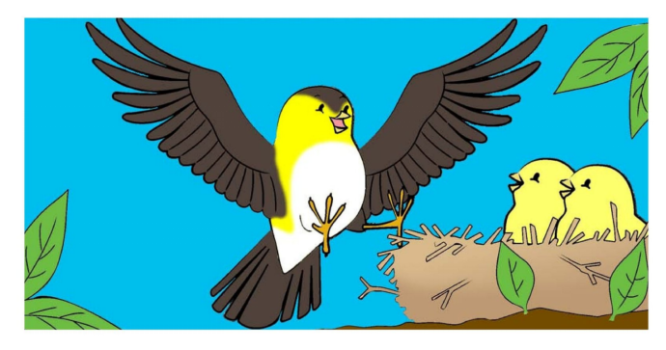
The bird goes home.

Slide 10
Click on the colored buttons to start getting to know them!
tree
farm
city
street
tables
cars
mountains
home

Slide 11
The bird goes over the tree.
Return

Slide 12
The bird goes over the farm.
Return

Slide 13
The bird goes over the city.
Return

Slide 14
The bird goes over the street.
Return

Slide 15
The bird goes over the tables.
Return

Slide 16
The bird goes over the cars.
Return

Slide 17
The bird goes over the mountains.
Return

Slide 18
The bird goes home.
Return

